Slide 1


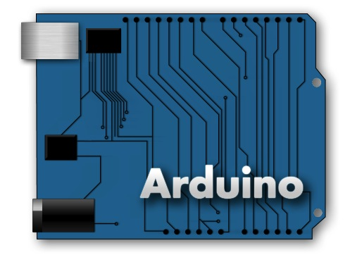
Introduction to
Arduino Programming
living with the lab
Gerald Recktenwald
Portland State University
gerry@me.pdx.edu
arduino.cc

Slide 2
references
living with the lab
these notes borrow from . . .
  Arduino web site
    http://arduino.cc/en/Guide/Environment
    http://arduino.cc/en/Tutorial/HomePage
  Adafruit tutorial #1 and 2
    http://www.ladyada.net/learn/arduino/lesson2.html
  Leah Buechley’s Introduction to Arduino
    http://web.media.mit.edu/~leah/LilyPad/03_arduino_intro.html

Slide 3
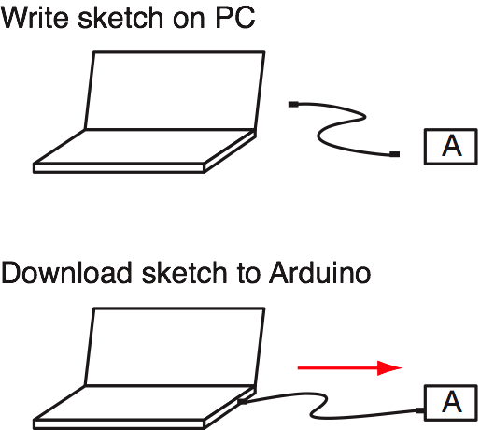
writing and downloading code
living with the lab

Slide 4
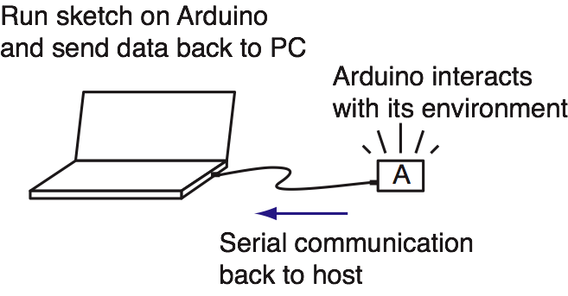
running Code while tethered
living with the lab

Slide 5
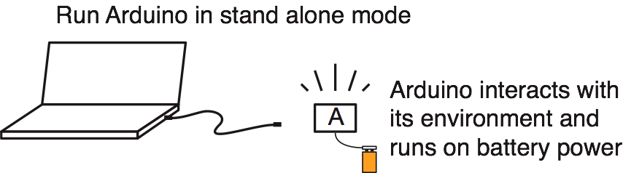
running code stand-alone
living with the lab

Slide 6
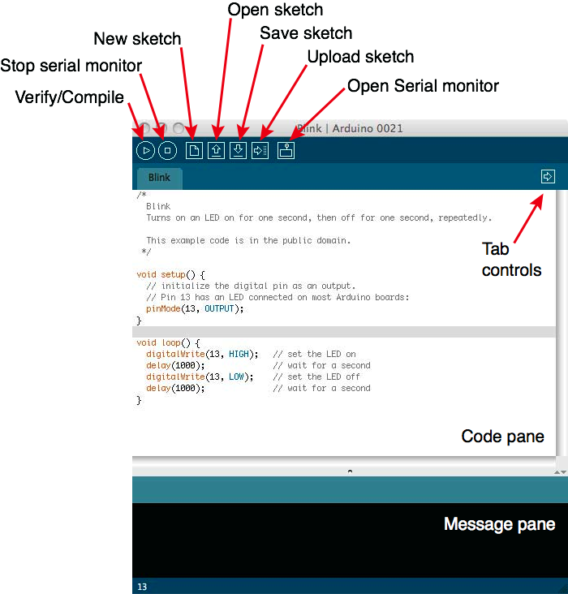
Arduino IDE
living with the lab
IDE = Integrated
Development
Environment
http://www.arduino.cc/en/Guide/Environment

Slide 7
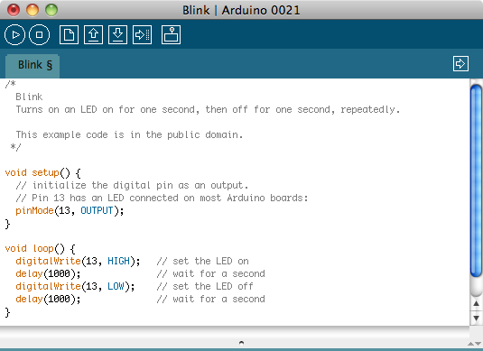
code structure: header
living with the lab
header provides information and
can also contain code

Slide 8
code structure: setup function
living with the lab
setup function is executed
only once at the start

Slide 9
code structure: loop function
living with the lab
loop function is
repeated indefinitely

Slide 10
code
living with the lab
pinMode(13, Output)
prepares pin 13 for
outputs of voltage
digital I/O functions:
pinMode
digitalWrite
digitalRead

Slide 11
code
living with the lab
digitalWrite(13, HIGH)
sets pin 13 to a voltage that
means “on” (five volts in this case)
digital I/O functions:
pinMode
digitalWrite
digitalRead

Slide 12
code
living with the lab
delay(1000);
tells microcontroller to do nothing for 1000 ms = 1 s
digital I/O functions:
pinMode
digitalWrite
digitalRead

Slide 13
living with the lab
code
digitalWrite(13, LOW)
sets pin 13 to voltage
that means “off” or zero volts
digital I/O functions:
pinMode
digitalWrite
digitalRead

